Slide 1

38: ProtoControl
Kelly Mae Allen, Abisha Fenn, Nida Kosedagi, Parker Sexton, William Wood
Notes:
Intro
Example user and how competitors don’t meet their needs
Functional Block Diagrams
System
User Flow
Subsystems
Designing a User Interface
Website
Peripherals
Implementation with User Interface
Integration (command library)
Communication
Microcontroller change
Functionality while systems running
Embedded
PCB
Power
Enclosure
Conclusion
“That’s why Shannon chooses protocontrol”
Demo Day Plans
Demo
Questions

Slide 2
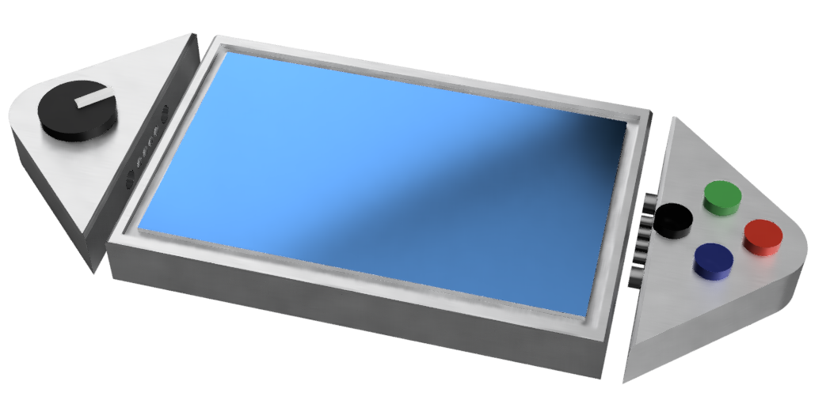
What is ProtoControl?
A plug and play panel with a start-to-finish user interface development experience.
Software platform to design user interface layout
Auto generated embedded code
Touch-screen display
Hot swappable hardware
Compatibility with industry standard technology
Nida Kosedagi
Notes:
Protocontrol allows engineers and hobbyists to execute their vision for a user interface panel with a start-to-finish user interface development experience
Bring the audience to the same place as us before diving into details, set the tone, differentiate ourselves from other projects

Slide 3
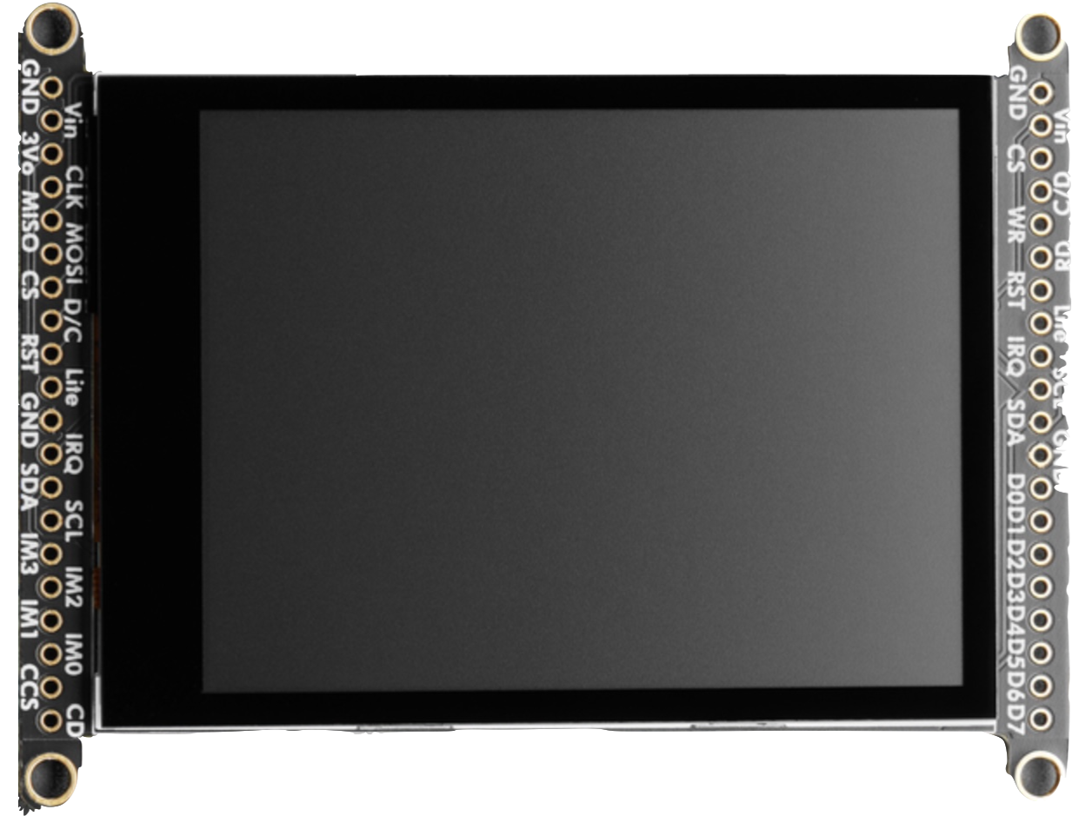
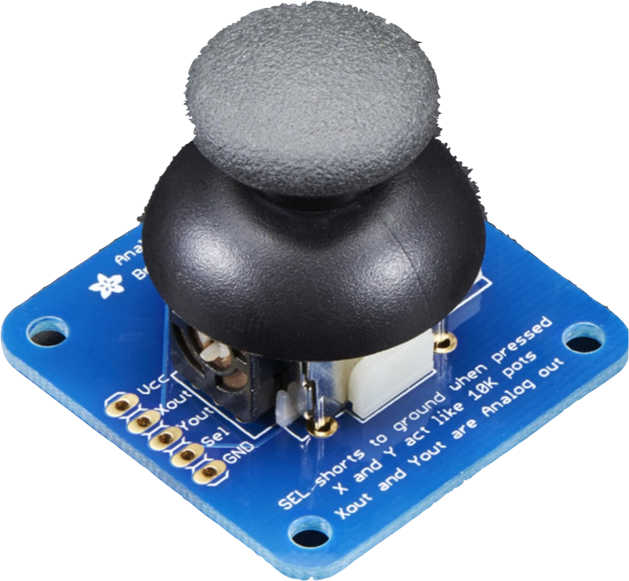
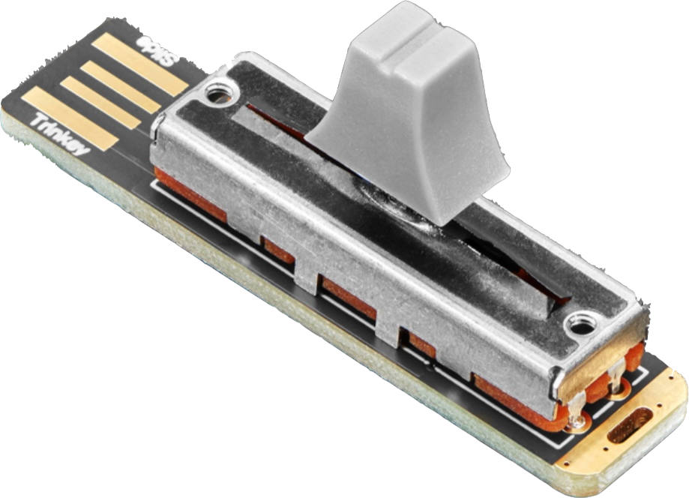
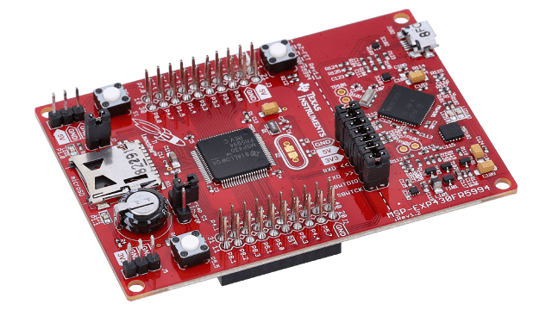
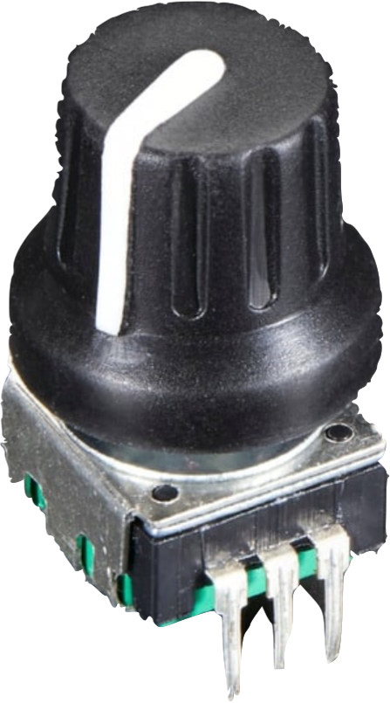
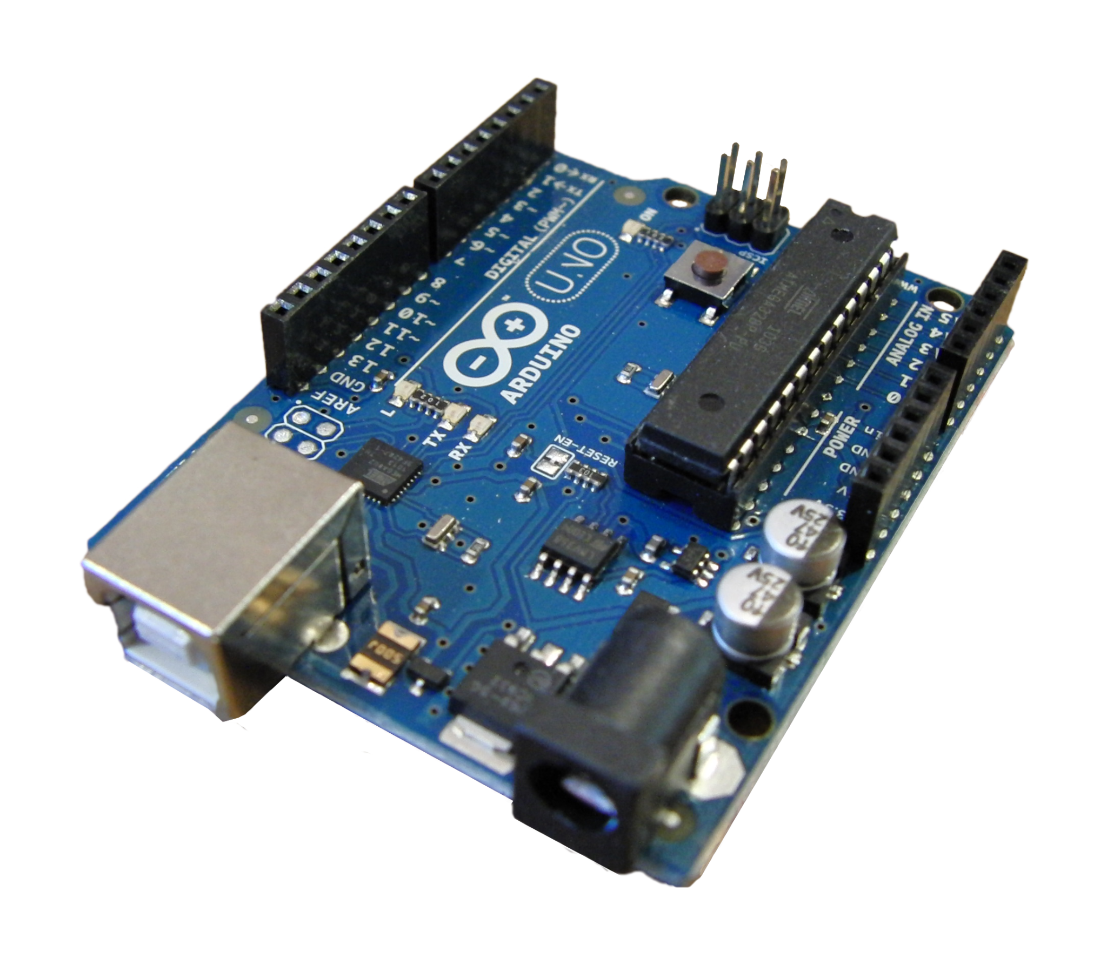
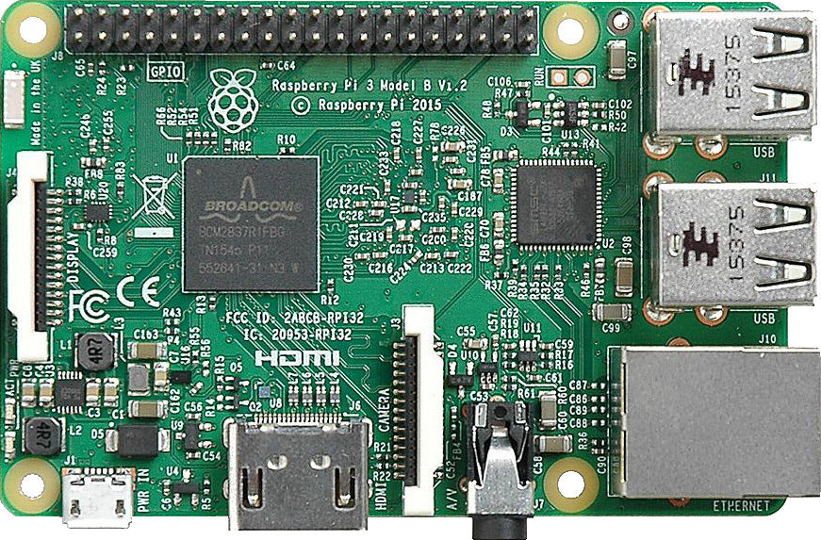
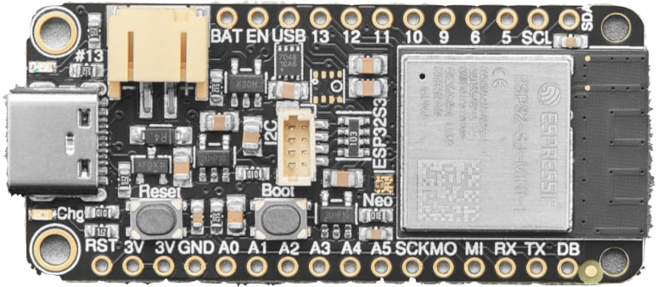
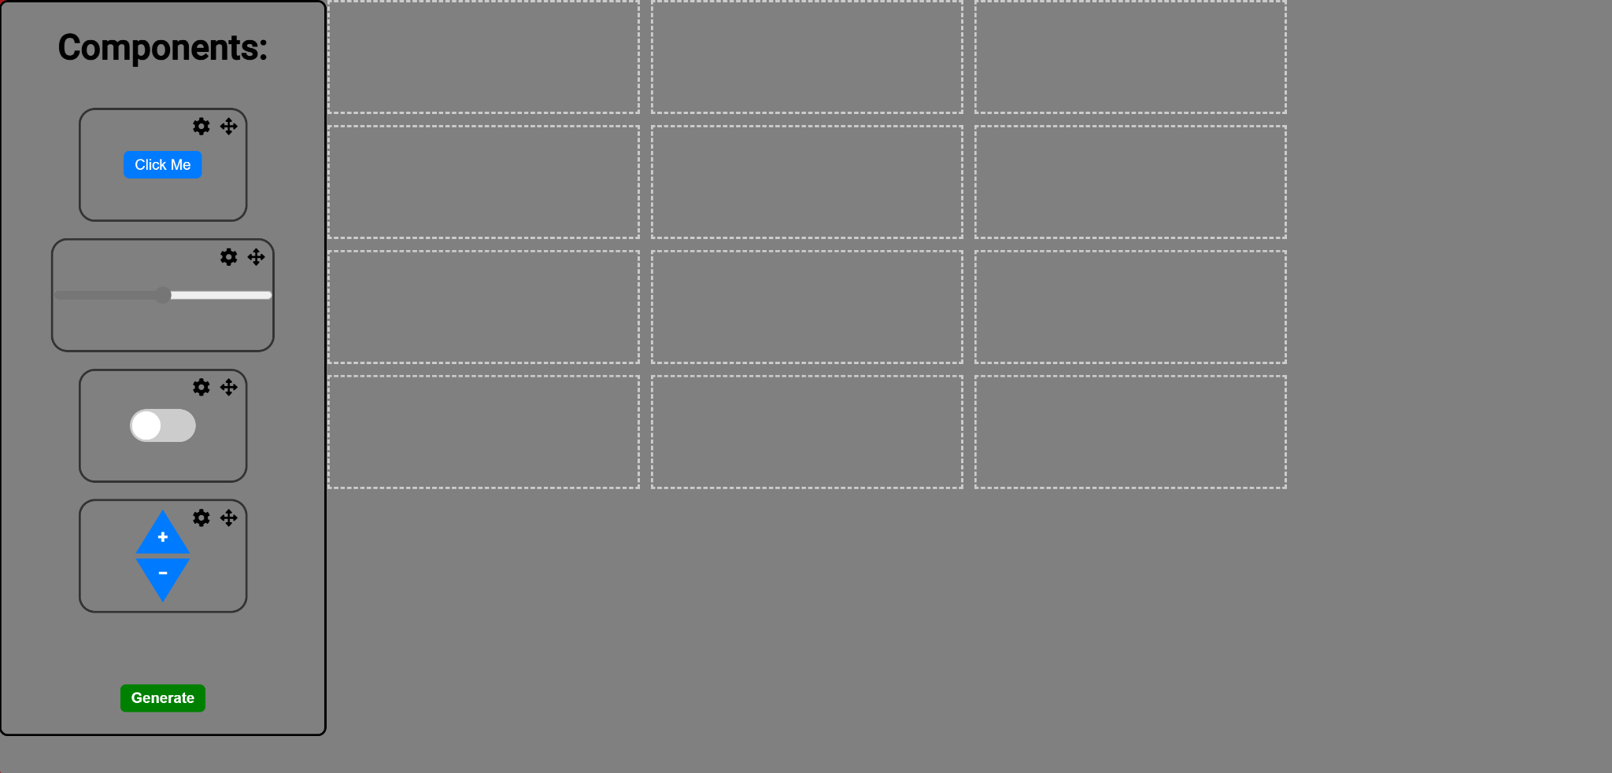
Functional Block Diagram
Display
I2C
I2C Peripherals
SPI
UART
WIFI
User System
Microcontroller
Website

Slide 4
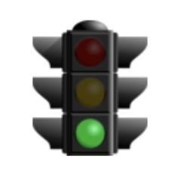
Updates and Project Status
Number | Description | Status
Website | Website prototype, Full database and UI connected
Embedded | Components working, Talking to website dynamically
PCB | PCB printed and tested, updates underway, component pcb ordered
I2C | Keypad, buttons, and rotary encoder work. Slider remains to be done, user system developed (servo, LEDs)
Power | Power tested for current system, no current tasks
Comm | Method developed, Integrated with user system
Enclosure | Model in progress, new pogo pins (for I2C communication)
General | Purchase order arrived!
Notes:
Mention that we are on track except for receiving purchase order

Slide 5
Website Progress
https://pages.github.ncsu.edu/ECE-Senior-Design-Fa2023-Sp2024/38-Protocontrol/
https://protocontrol.pythonanywhere.com/retrieve-all

Slide 6
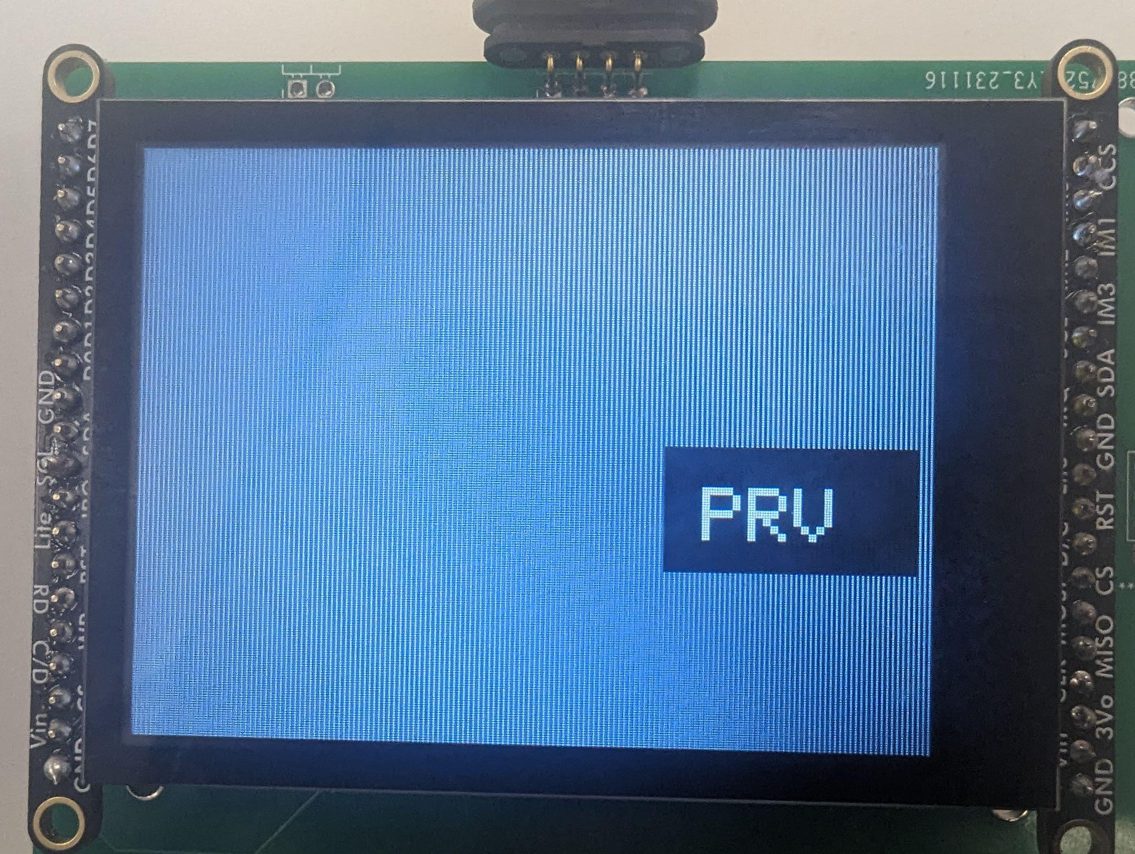
Embedded progress
Five digital components working from website
I2c physical components all working simultaneously
Console and Serial communication
User system code examples designed

Slide 7

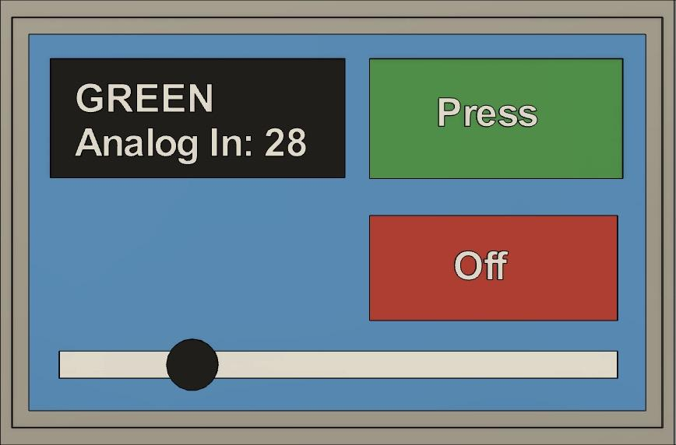
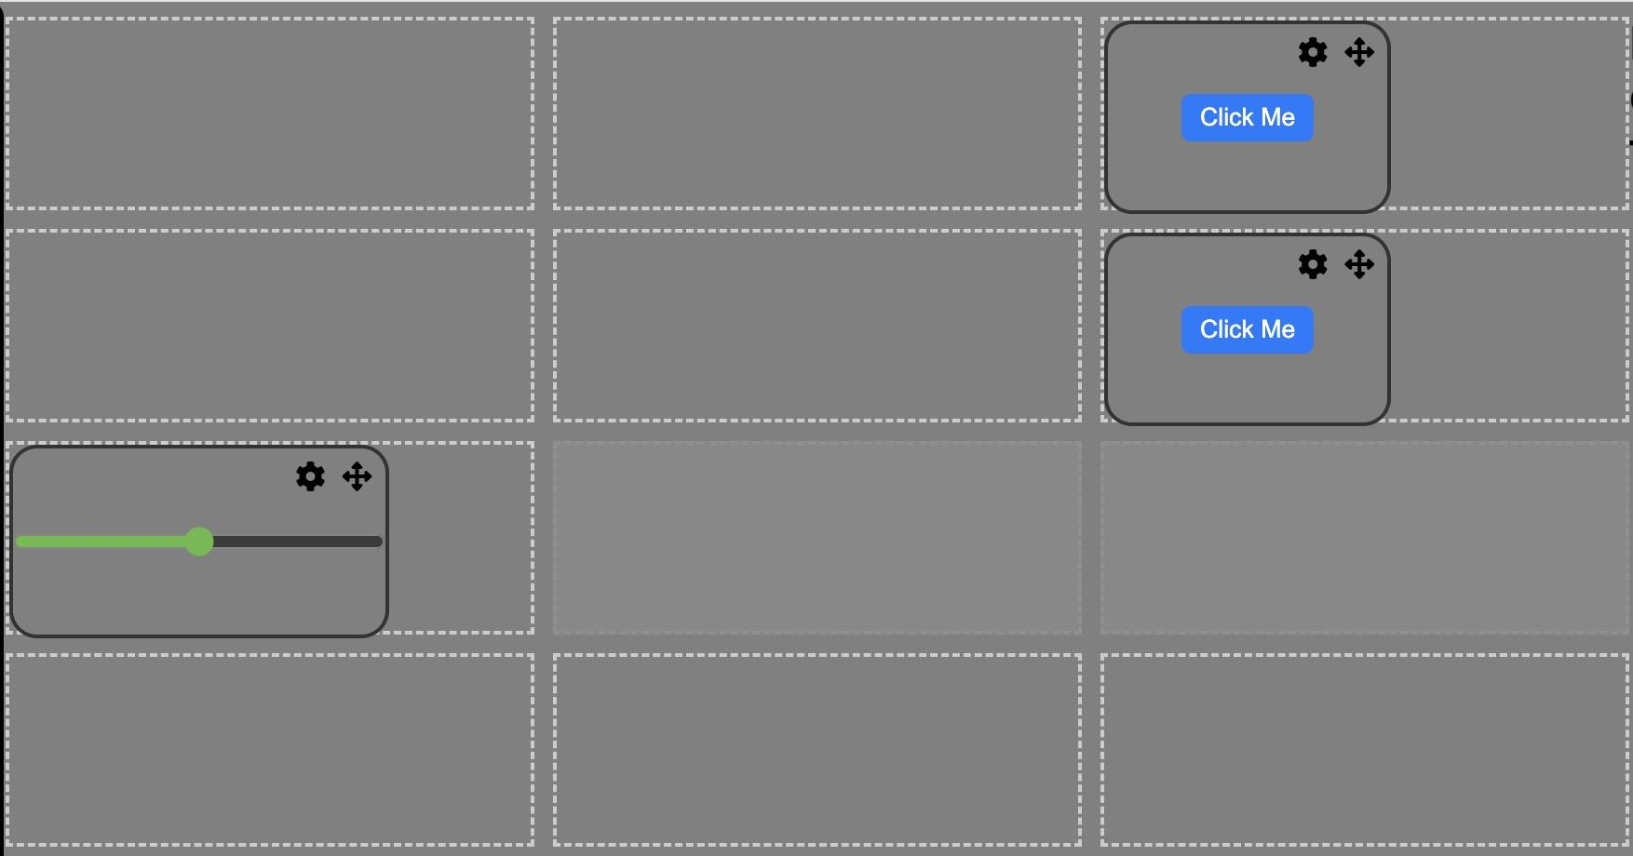
Integration between Protocontrol and User System
Command Protocol
+[component tag]|[value]
x1
x2
x3
Component Tag
- Each component is assigned a unique component identifier assigned by the website that is known to the user
Digital Component
Tag assigned by grid location on website
Hardware Component
Tag assigned by website when chosen
x4
x5
x6
x7
x8
x9
xA
xB
xC
Notes:
Not rlly sure how this slide is relevant, at the very least it should not be the first slide for this subsystem

Slide 8
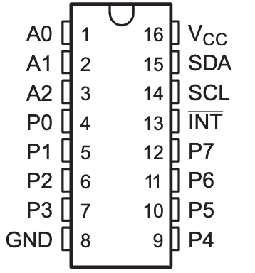
Hardware Peripheral Demo
Current Achievements
Initialization Steps, printing out received data, Stable data, swapability (re-flash required)
Buttons, Keypad, Rotary Encoder!
Both ports on PCB function with analog and digital components (control servo angle)
Circumvent Website; instead use scan/initial begin functions upon startup
Next Steps: multiple components on same pcf chip, port design, Slider

Slide 9
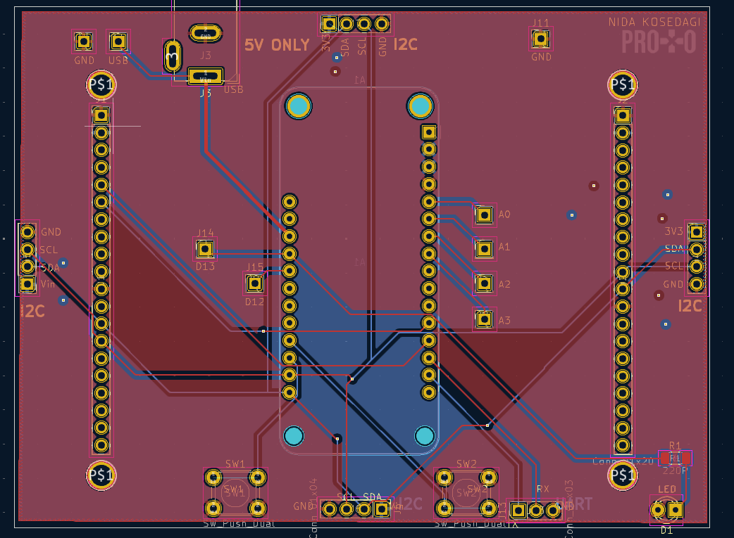
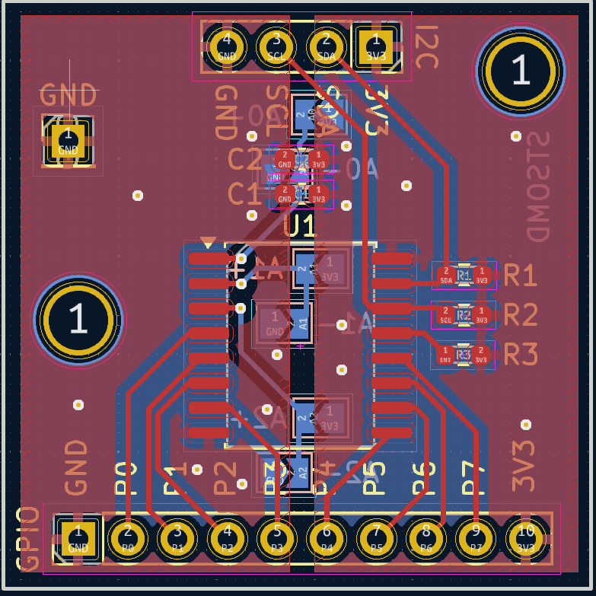
PCB Design
Redesigned the component PCB after review with mentor
Added solder pads for the address lines
Got rid of the loop traces
New main board design in progress

Slide 10
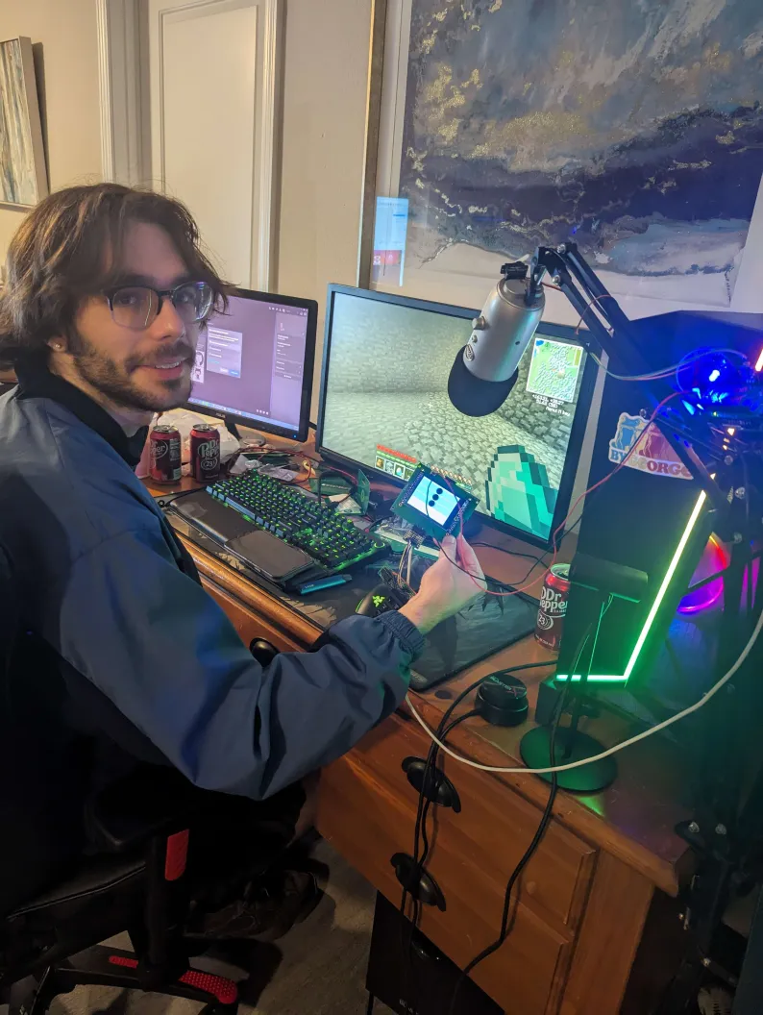
User Demo Results
More labels on the website and the touchscreen
Break down the code in the user manual (almost textbook style
Common Mistakes
Notes:
User feedback
How intuitive does it feel as an end user?
How intuitive is it as a customer?
See the Arduino User System Code

Slide 11
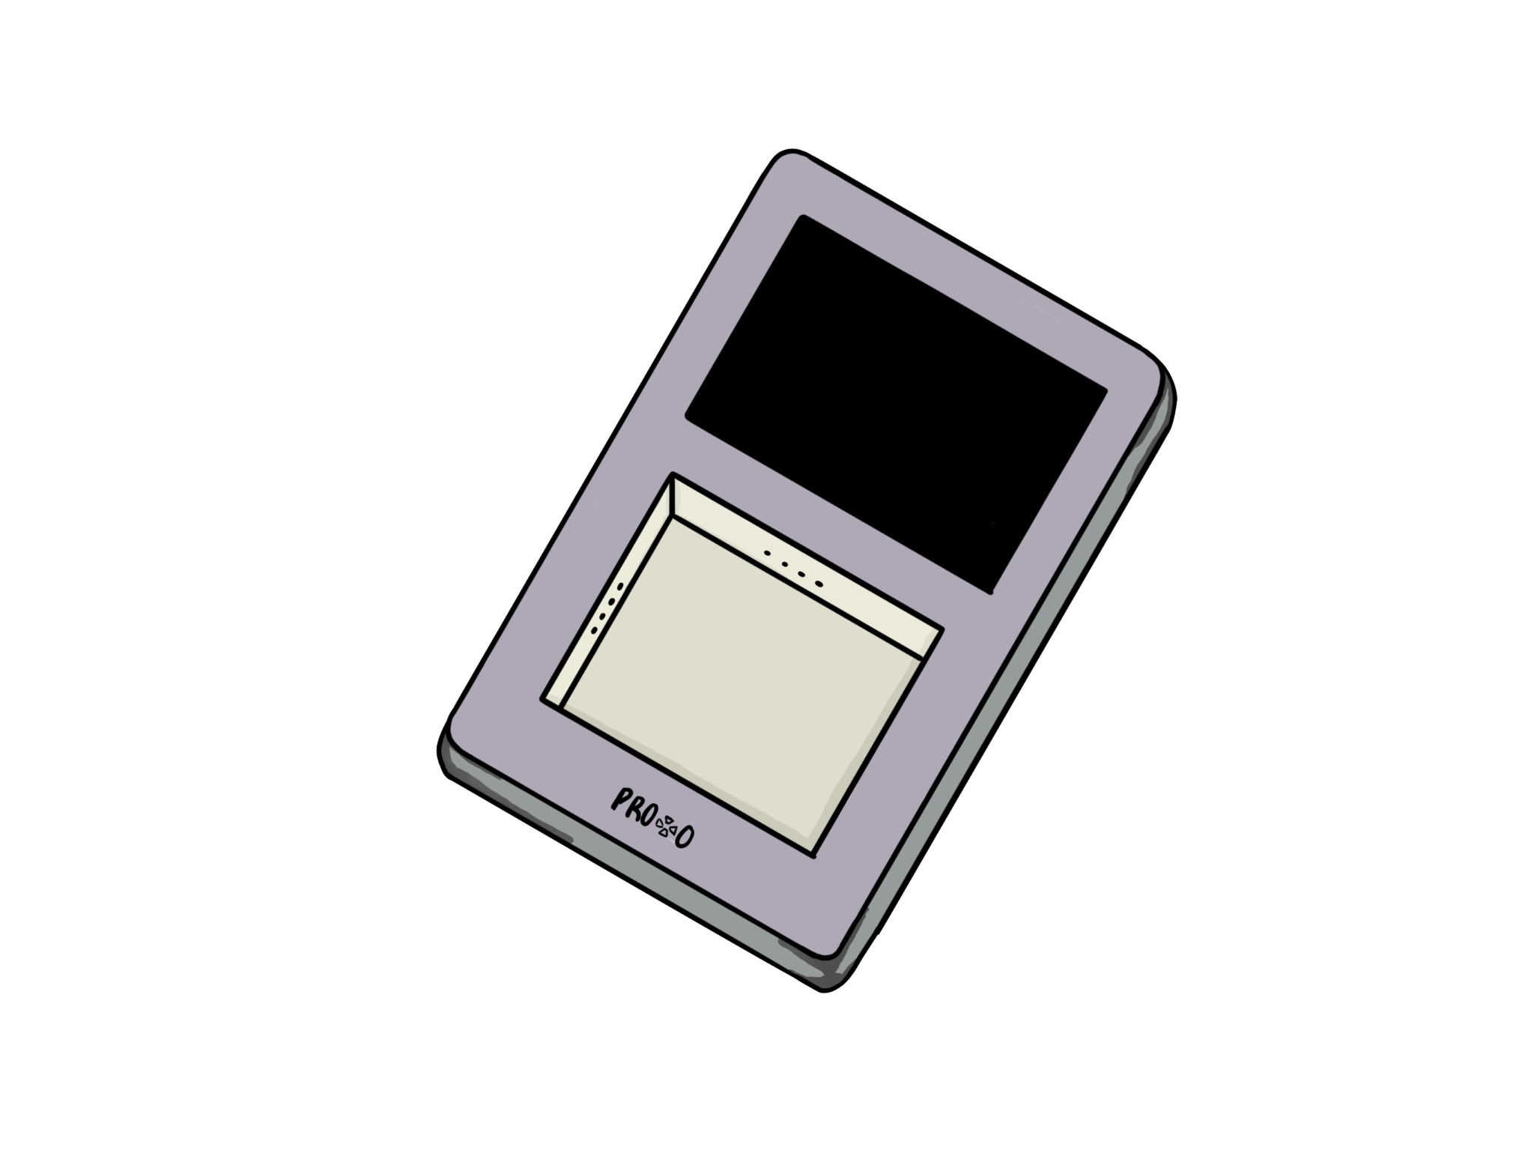
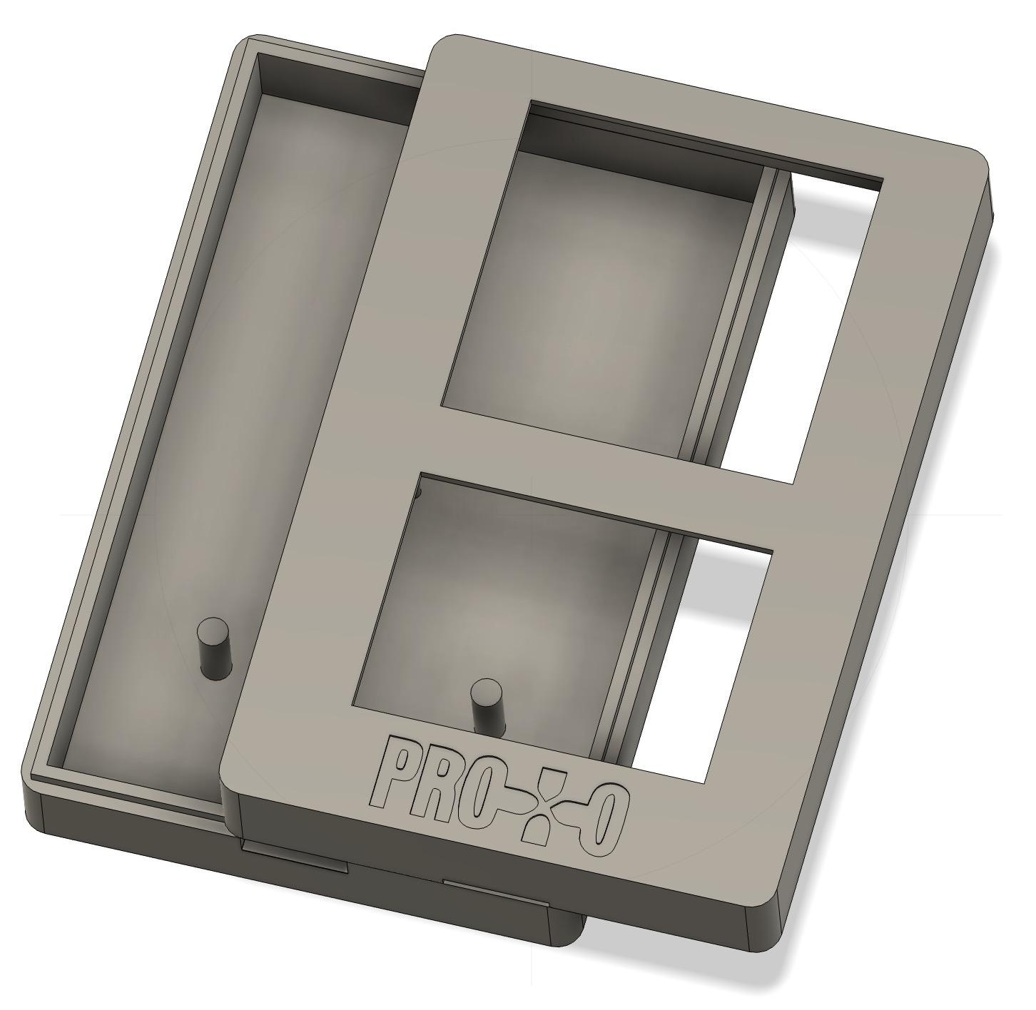
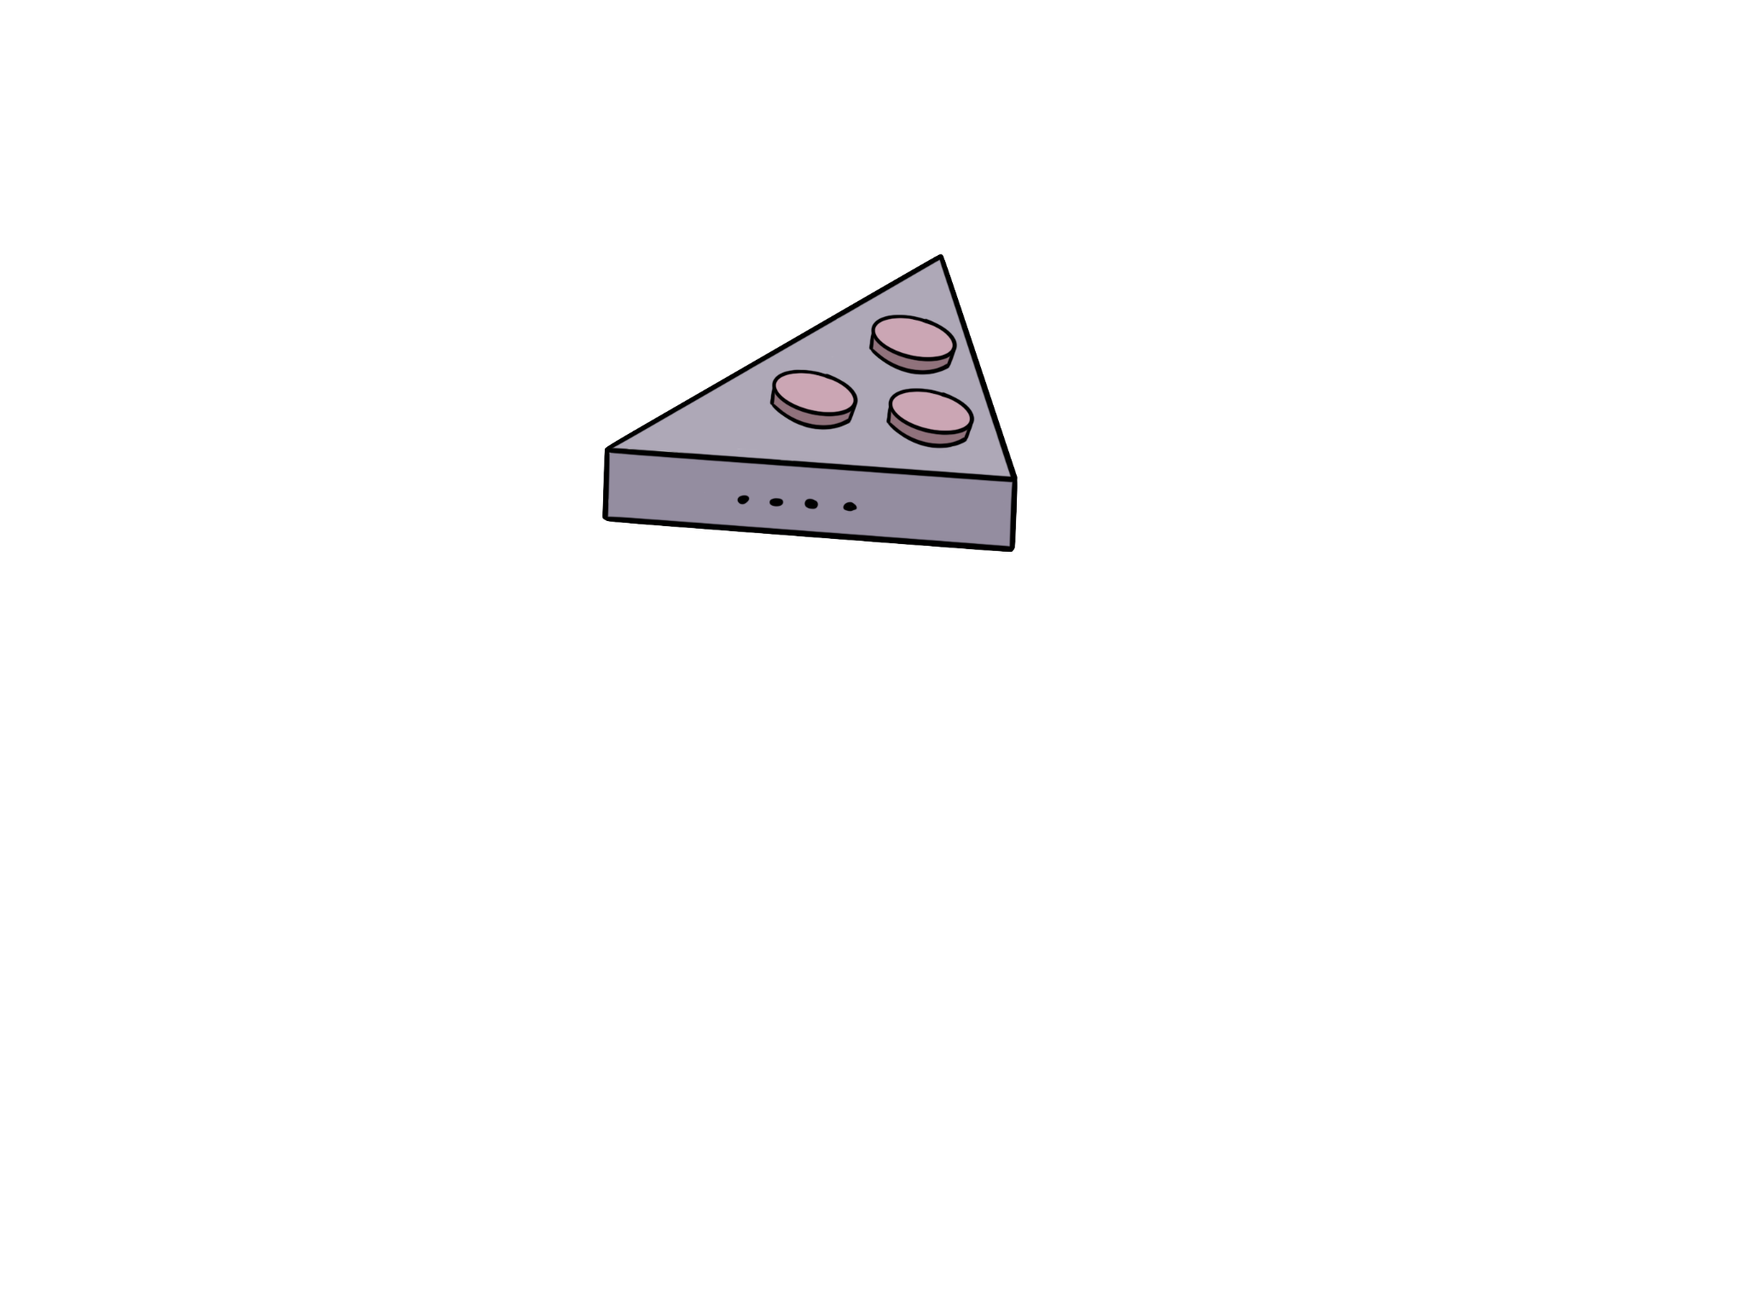

Integration and Enclosure Progress
Integration
Enclosure
Decided on message format
send(ID,value)
X = receive_update
Utilizing binary messaging across UART channel to capacity used
Building Arduino Library for simple user implementation
Printed new design
Sent purchase order for custom connectors
Fusion360 Design
Sketch

Slide 12

Team Charter

